Slide 1




Xamarin training
for mobile app development professionals
Write once, run everywhere*
*Terms and conditions apply

Slide 2
Agenda
Xamarin.Forms basics
Architecture and plumbing
Customization
Xamarin.Forms 4.0
Notes:
Xamarin.Forms essentials
Pages
Layouts
Controls
DataPages
ListViews
DataTemplateSelectors
Architecture and plumbing
Commands
Two-way data binding
Navigation
DependencyService
MessagingCenter
MVVM
Customization
OnPlatform
Effects
Behaviors
Custom renderers
Platform specifics
Native embedding
Native view declarations and bindings

Slide 3
Xamarin.Forms basics

Slide 4
Xamarin.Forms essentials
A framework that allows developers to rapidly create cross-platform user interfaces
Provides its own abstraction for the UI that will be rendered using native controls on iOS, Android, or Windows
Applications can share a large portion of their UI code and still retain the native look and feel of the target platform

Slide 5
Xamarin + Xamarin.Forms
iOS C# UI
Android C# UI
Windows C# UI
Shared UI code
Shared C# backend
Shared C# backend
Traditional Xamarin approach
With Xamarin.Forms: more code-sharing, all native

Slide 6
Choosing between Xamarin.Forms and native
When to choose Xamarin.Forms
Ideal for enterprise apps, PoCs
Great when UI is similar on all target platforms
Good choice when lots of highly custom UI is not required
When to choose native (Xamarin.iOS, Xamarin.Android, or UWP)
Highly customized visual consumer apps
Apps whose design differs greatly between platforms
When the Xamarin.Forms approach requires lots of custom renderers

Slide 7






When choosing between Forms or Native, first ask questions
Forms sounds good
Do you want similar UI on all platforms?
Native!
Will the app require a lot of custom renderers?
Forms!
Is code reuse more important than pixel-perfect layout?
Choose native!
Do you need to use a lot of native platform SDK features?
Xamarin.Forms
Xamarin.iOS Xamarin.Android

Slide 8
What Xamarin.Forms includes
40+ pages, layouts, and controls
(Build from code behind or XAML)
Two-way data binding
Navigation
Native embedding
Custom renderers
Animation API
Dependency Service
Messaging Center
Shared UI code
Shared C# Backend

Slide 9
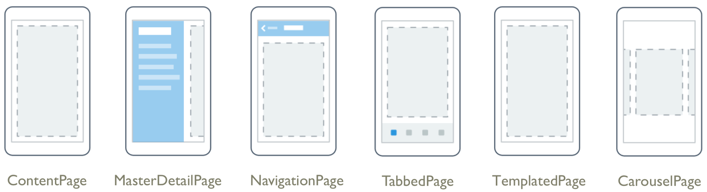
Pages
A Xamarin.Forms.Page maps to a View Controller in iOS and a Page in Windows Phone. On Android each page takes up the screen like an Activity, but Xamarin.Forms Pages are not Activities.
ContentPage: Displays a single View, often a container such as a StackLayout or a ScrollView.
MasterDetailPage: Manages two panes of information.
NavigationPage: Manages the navigation and user experience of a stack of other pages.
TabbedPage: Allows navigation between child pages using tabs.
TemplatedPage: Displays full-screen content with a control template; the base class for a ContentPage.
CarouselPage: Allows swipe gestures between subpages, like a gallery.

Slide 10
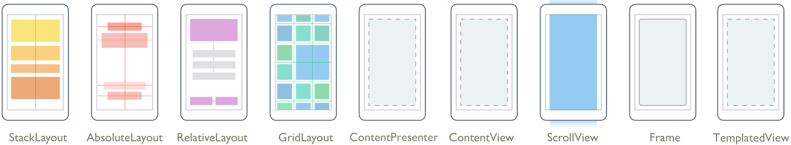
Layouts
The Layout class in Xamarin.Forms is a specialized subtype of View, which acts as a container for other Layouts or Views. It typically contains logic to set the position and size of child elements in Xamarin.Forms applications.
StackLayout: Positions child elements in a single line, oriented vertically or horizontally. Sets the child bounds automatically during a layout cycle. User-assigned bounds will be overwritten and thus should not be set on a child element by the user.
AbsoluteLayout: Positions child elements at absolute requested positions. User-assigned anchors and bounds define the position and size of the control.
RelativeLayout: Uses Constraints to lay out its children.
GridLayout: Contains views arranged in rows and columns.
ContentPresenter: A layout manager for templated views used within a ControlTemplate to mark where presented content appears.
ContentView: An element with a single content, which has very little use of its own. Its purpose is to serve as a base class for user-defined compound views.
ScrollView: An element capable of scrolling if its content requires it.
Frame: An element that contains a single child with some framing options. This layout has a default Xamarin.Forms.Layout.Padding of 20.
TemplatedView: An element that displays content with a control template, and the base class for ContentView.
FlexLayout: Used to arrange views horizontally or vertically with wrapping.

Slide 11
Views (controls or widgets)
Xamarin.Forms uses the word View to refer to visual objects such as buttons, labels, or text entry boxes, which may be more commonly known as controls or widgets.
ActivityIndicator
BoxView
Button
DatePicker
Editor
Entry
Image
Label
ListView
Map
OpenGLView
Picker
ProgressBar
SearchBar
Slider
Stepper
TableView
TimePicker
WebView
EntryCell
ImageCell
SwitchCell
TextCell
ViewCell

Slide 12
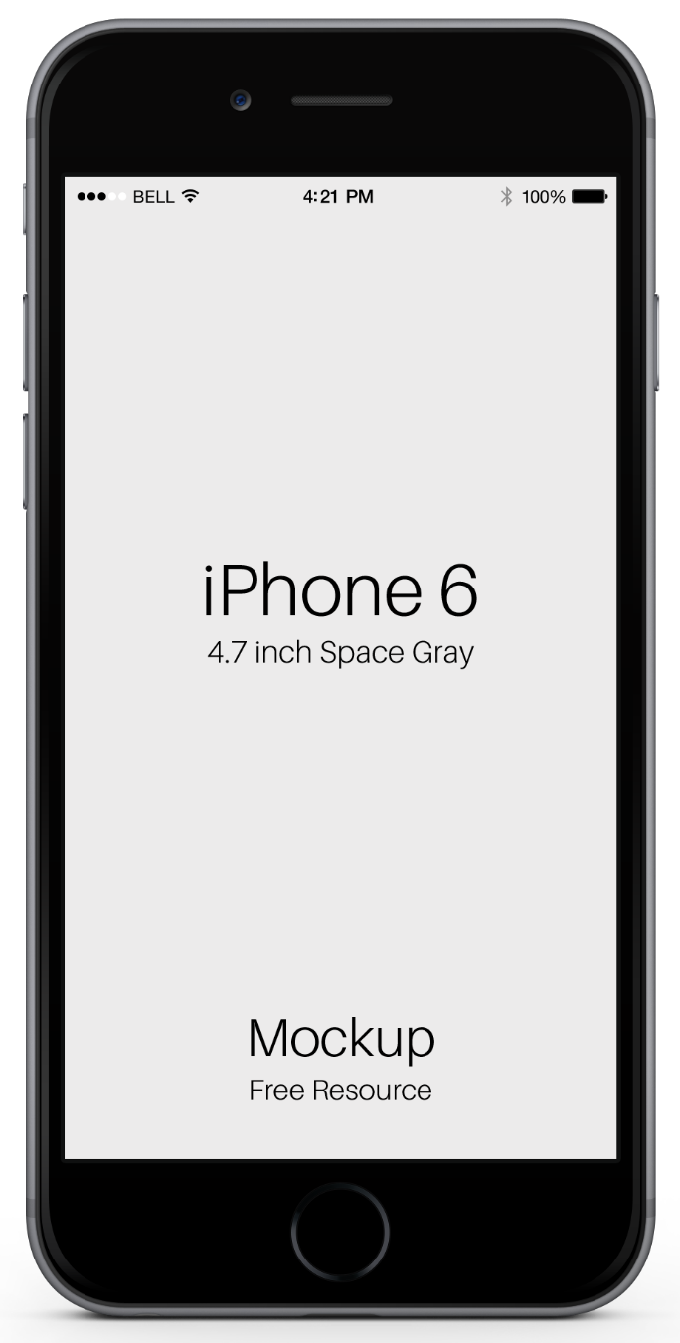

Animations
Animate any VisualElement using a set of extension methods provided by ViewExtensions
Methods provided include TranslateTo, ScaleTo, RelScaleTo, RotateTo, RelRotateTo, RotateXTo, RotateYTo, FadeTo, and CancelAnimations
As async operations, they can be awaited to make the animations run sequentially or not awaited to make them run in parallel
They return false if completed and true if cancelled
await ShadeBox.TranslateTo(0, 0, 1500, Easing.BounceOut);

Slide 13
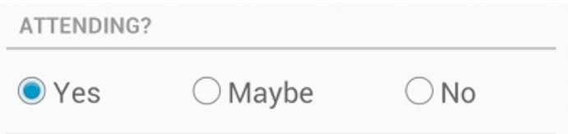
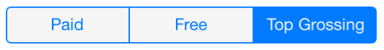
Xamarin.Forms: Coverage of controls
Android controls
Xamarin.Forms offers those controls that are common to all three platforms
iOS controls
Android and UWP use radio buttons but iOS doesn’t
UWP controls
Xamarin.Forms controls
ActivityIndicator
DatePicker
Button
TableView
BoxView
Image
iOS offers a segmented control but Android and UWP doesn’t
Slider
SearchBar
Picker
TimeView
Entry
Editor
WebView
Switch
Label
Stepper
ProgressBar
ListView

Slide 14

Controls and layouts best practices
Beware of relative cost of each layout control
Keep layout as lean and fast as possible
Keep visual tree shallow
Small individual gains add up
Ensure lists are optimized
Labels are expensive
When your layout hierarchy starts to become complex, consider creating a custom layout.
See Jason Smith’s Evolve talk on Custom Layouts at www.youtube.com/watch?v=sxjOqNZFhKU

Slide 15
Relative cost of controls
Relative layout
Grid layout
Flex layout
Stack layout
Absolute layout
Single element
Slower
Faster
Grid layout can be very fast (highly performant) if you don’t use auto

Slide 16
Fast Renderers
Added in Xamarin.Forms 2.4
Reduces inflation and rendering costs of a Xamarin.Forms control on Android by flattening the resulting native control hierarchy
Fast renderers are available for the following:
Button
Image
Label
Frame
From Xamarin.Forms 4.0 onwards, all applications targeting FormsAppCompatActivity will use these fast renderers by default
To use in previous versions of Forms, add Forms.SetFlags("FastRenderers_Experimental"); in MainActivity before Forms.Init
Potential performance increase up to 2x
Notes:
Traditionally, most of the original control renderers on Android are composed of two views:
A native control, such as a Button or TextView.
A container ViewGroup that handles some of the layout work, gesture handling, and other tasks.
However, this approach has a performance implication in that two views are created for each logical control, which results in a more complex visual tree that requires more memory, and more processing to render on screen.
Fast renderers reduce the inflation and rendering costs of a Xamarin.Forms control into a single view. Therefore, instead of creating two views and adding them to the view tree, only one is created. This improves performance by creating fewer objects, which in turn means a less complex view tree, and less memory use (which also results in fewer garbage collection pauses).
https://docs.microsoft.com/en-us/xamarin/xamarin-forms/internals/fast-renderers

Slide 17

Another best practice: Enable XAML compilation
Compile time checking of XAML
Removes load and instantiating time of XAML elements
Reduces file size: .xaml files no longer included
Easily enabled using a single assembly level attribute:
using Xamarin.Forms.Xaml;
...
[assembly: XamlCompilation (XamlCompilationOptions.Compile)]
namespace PhotoApp
{
...
}
When you’re developing very large apps, you might want to turn off compilation during test run builds. Instead, use it only for release and beta builds

Slide 18
Another best practice: Enable Compiled Bindings
Compile time checking of bindings
Removes load and instantiating time of XAML bindings
Requires XAML compilation
Up to 20x performance increase for OneTime bindings with no property change notification and 5x increase for bindings with property change notifications
Easily enabled using a XAML attribute:
x:DataType
<ListView x:Name="colorListView" ItemsSource="{x:Static local:NamedColor.All}" ... >
<ListView.ItemTemplate>
<DataTemplate x:DataType="local:NamedColor">
<ViewCell>
<StackLayout Orientation="Horizontal">
<BoxView Color="{Binding Color}" ... />
<Label Text="{Binding FriendlyName}" ... />
</StackLayout>
</ViewCell>
</DataTemplate>
</ListView.ItemTemplate>
</ListView>
The x:DataType attribute can be redefined at any point in a view hierarchy

Slide 19
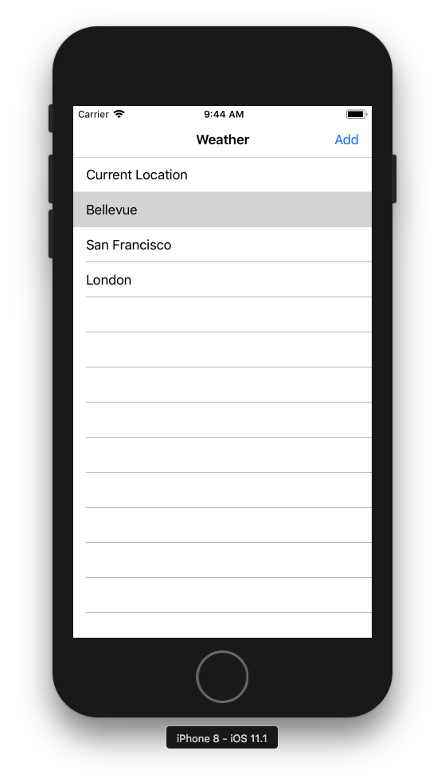
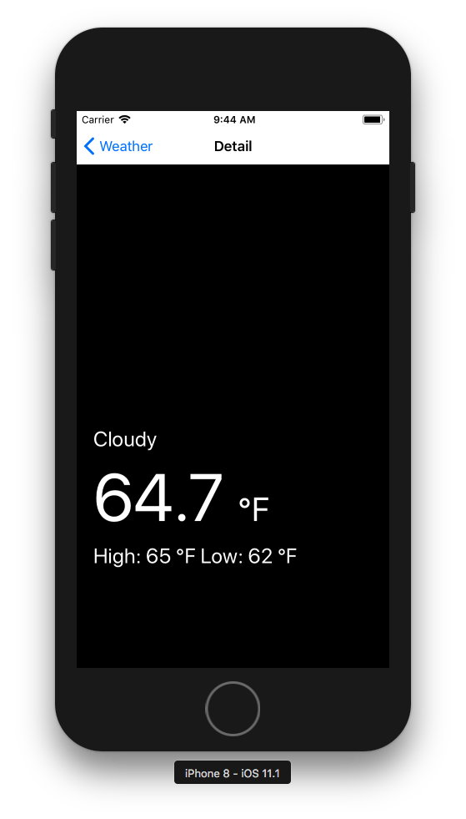
Exercise 1: Create a XAML layout
Open Forms_Exercise1_Begin
Add a page for the Detail view
Build the UI for both the list and the Detail view as shown here
Note: You can use static data for the purposes of this exercise

Slide 20
Exercise 1: Create a XAML layout
WeatherListView:
Create a simple ListView
Add some hardcoded city names to the list
Place an Add button in the Page toolbar
Navigate to Detail page on selection
WeatherDetailView:
Lay out the Detail UI as shown
Background image
Weather description
Current temp with small temp unit
High/Low temperatures

Slide 21
Exercise 1: Create a XAML layout
HINT:
You can use a simple string inline array as a ListView ItemSource in the XAML:
<x:Array Type="{x:Type x:String}"> <x:String>Current Location</x:String> <x:String>Bellevue</x:String> <x:String>San Francisco</x:String> <x:String>London</x:String>
</x:Array>

Slide 22
Q & A

Slide 23
Architecture and plumbing

Slide 24
Architecture and plumbing
MVVM
Commands
Data binding
Navigation
DependencyService
MessagingCenter
ListView
DataTemplateSelectors

Slide 25
MVVM
View
Presentation
DataBinding & Commands
ViewModel
View abstraction and presentation logic
References
&
Dependency Injection
Model
Business logic and data
Notes:
MVVM- The MVVM pattern lends itself naturally to Xamarin.Forms. This is because the MVVM pattern leverages some of the specific capabilities of the platform, such as data binding, commands, and behaviors.
MVVM is similar to many other patterns that separate the responsibility for the appearance and layout of the UI from the responsibility for the presentation logic; for example, if you're familiar with the Model-View-Controller (MVC) pattern, you'll find that MVVM has many similar concepts.
Minimal code in code behind. Either defined in view logic in MarkUp or using converters or behaviours.

Slide 26
Commands
Provides a mechanism to execute methods in the ViewModel using bindings from the view
Avoids implementing behavior in the view/code behind
Xamarin.Forms provides an implementation of the ICommand
Methods
CanExecute(Object) defines the method that determines whether the command can execute in its current state
Execute(Object) defines the method to be called when the command is invoked
Events
CanExecuteChanged occurs when changes occur that affect whether or not the command should execute
Notes:
https://developer.xamarin.com/guides/xamarin-forms/creating-mobile-apps-xamarin-forms/summaries/chapter18/
https://msdn.microsoft.com/en-us/library/system.windows.input.icommand(v=vs.110).aspx

Slide 27
Data binding
Automates the process of writing event handlers that detect when a property of one object has changed and uses that to change the value of a property in another object
Usually defined in XAML and becomes part of the definition of the user interface
Data bindings connect UI objects to the properties of the BindingContext
You can set the Mode property of Binding to a member of the BindingMode enumeration:
OneWay so that changes in the source property affect the target
OneWayToSource so that changes in the target property affect the source
TwoWay so that changes in the source and target affect each other
Default to use the DefaultBindingMode specified when the target BindableProperty was created
If not specified, the default is OneWay for normal bindable properties, and OneWayToSource for read only

Slide 28
Navigation
Xamarin.Forms provides different navigation experiences, depending upon the Page type.
Hierarchical navigation: The NavigationPage class provides a hierarchical navigation experience so the user can navigate forward and backward through pages. The class implements navigation as a last-in, first-out (LIFO) stack of Page objects.
TabbedPage: The TabbedPage consists of a list of tabs and a larger detail area, with each tab loading content into the detail area.
CarouselPage: The CarouselPage lets users swipe from side to side to navigate through pages of content, like a gallery.
MasterDetailPage: The MasterDetailPage page manages two pages of related information – a master page that presents items, and a detail page that presents details about items on the master page.
Modal pages: Xamarin.Forms also provides support for modal pages, which encourage users to complete a self-contained task that cannot be navigated away from until the task is completed or cancelled.
Pop-ups: Xamarin.Forms provides two pop-up–like UI elements: an alert and an action sheet. You can use these elements to ask users simple questions or guide them through tasks.

Slide 29
DependencyService
Xamarin.Forms lets developers define behavior in platform-specific projects. DependencyService then finds the right platform implementation, allowing shared code to access the native functionality.
DependencyService allows apps to call into platform-specific functionality from shared code so Xamarin.Forms apps can do anything that a native app can do.
DependencyService is a dependency resolver. In practice, an interface is defined and DependencyService finds the correct implementation of that interface from the various platform projects.

Slide 30
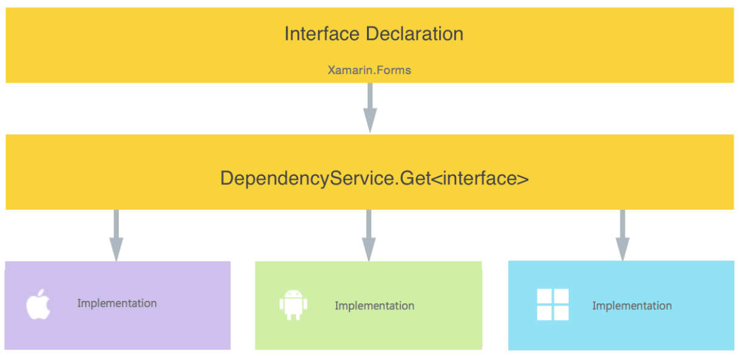
DependencyService details
Xamarin.Forms apps need these components to use the DependencyService:
Interface: Define the required functionality in shared code.
Implementation per platform: Add the classes that implement the interface to each platform project.
Registration: Register each implementing class with DependencyService via a metadata attribute to let DependencyService find the implementing class and supply it in place of the interface at run time.
Call to DependencyService: Shared code explicitly calls DependencyService to ask for implementations of the interface.

Slide 31
MessagingCenter
Xamarin.Forms MessagingCenter is a simple messaging service you can use to send and receive messages.
Its message contract enables view models and other components to communicate without having to know anything about each other.
The MessagingCenter includes two simple actions:
Subscribe: Listen for messages with a certain signature and perform some action when they are received. Multiple subscribers can listen for the same message.
Send: Publish a message for listeners to act upon. If no listeners have subscribed, the message is ignored.
The Mobile Customer Advisory team generally suggests that you not use the MessagingCenter service because it can cause memory leaks and lead to poorly architected apps.
Notes:
The MessagingCenter is a static class with Subscribe and Send methods that are used throughout the solution.
Messages have a string message parameter that is used to address messages. The Subscribe and Send methods use generic parameters to further control how messages are delivered.
Two messages with the same message text but different generic type arguments will not be delivered to the same subscriber.
Messages may be sent as a result of user-interaction (a button click), a system event (controls changing state) or some other incident (an asynchronous download completing). Subscribers might be listening in order to change the appearance of the user interface, save data, or trigger some other operation.

Slide 32
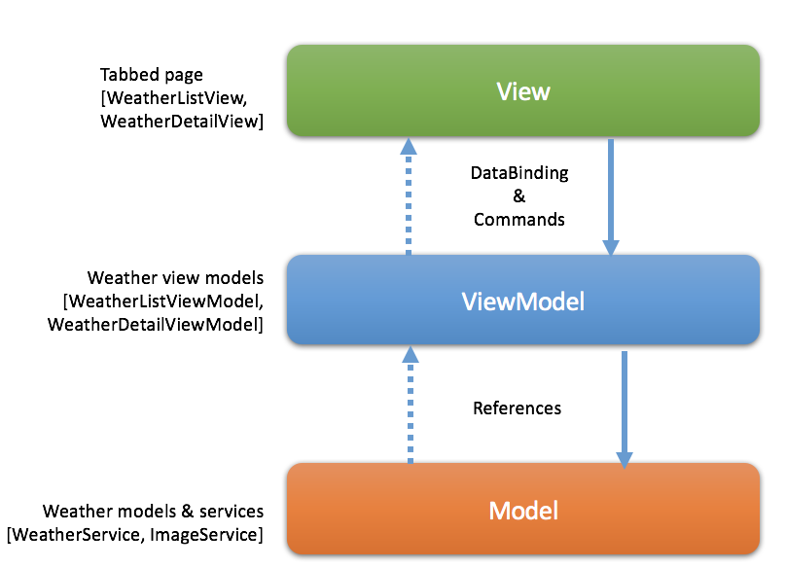
Exercise 2: Add plumbing
Open Forms_Exercise2_Begin.zip
Hook up each view to the appropriate ViewModel
Replace the static data with data bindings to ViewModel properties. This should include:
Page titles
Label text values
Background image
Add button command (showing the alert entry)
Weather list refresh command
Note: You should use the existing ViewModels from the previous exercises

Slide 33
ListView
ListView is a view for presenting lists of data, especially long lists that require scrolling. ListViews support context actions and data binding.
Best suited for homogeneous data – data that is of the same type.
Binding to an ItemsSource
ListView is populated with data using the ItemsSource property, which can accept any collection implementing IEnumerable.
Defining an ItemTemplate
The ItemTemplate defines the visual appearance of objects from the ItemsView<TVisual>.ItemsSource. Use it to set up data bindings to the user objects supplied to automatically fill in the visual and respond to any changes in the user object.
See Jason Smith’s Evolve talk on Optimizing App Performance with Xamarin.Forms www.youtube.com/watch?v=RZvdql3Ev0E

Slide 34
ListView optimization
Where possible, use ListView instead of the much less efficient legacy TableView
Use built-in Cell types when possible
Don’t embed a ListView within a ScrollView
Don’t embed a ListView within a ListView
Avoid data binding for long lists with lots of bindings for each item
Avoid using layouts that require measurement (stack layout, grid with "auto,“ etc.) in ListView cells
Use appropriate caching strategy
Retain (Default)
RecycleElement
RecycleElementAndDataTemplate
Usually best to use RecycleElement or RecycleElementAndDataTemplate
Cell recycling
<ListView CachingStrategy="RecycleElement">
Notes:
List are probably on of the most common elements in applications so they need to be as efficient as possible
Caching strategy
RetainElement (current default but plans to change to Recycle) Generates new cell for each element for frequently changing templates with large number of bindings
RecycleElement Recycles cells to minimize memory footprint and maximize execution speed, cells are similar
Avoid placing a ListView inside a ScrollView for the following reasons:
The ListView implements its own scrolling.
The ListView will not receive any gestures, as they will be handled by the parent ScrollView.
The ListView can present a customized header and footer that scrolls with the elements of the list, potentially offering the functionality that the ScrollView was used for.
https://developer.xamarin.com/api/type/Xamarin.Forms.ListViewCachingStrategy/
https://developer.xamarin.com/guides/xamarin-forms/user-interface/listview/performance/

Slide 35
ListView ViewCells
Built in cells
Text cell, Image cell, Switch cell, Entry cell
Custom cells / DataTemplates
DataTemplate example:
<ListView.ItemTemplate> <DataTemplate> <ViewCell> <ViewCell.View> <StackLayout Padding="16,10" Spacing="4” HeightRequest="100”> <Label Text="{Binding League.Name}" FontSize="Large"/> <StackLayout Spacing="4" Padding="0,10” HeightRequest=”50”> <Label Text="{Binding League.StartDate, StringFormat=’Start \{0:D\}'}"/> <Label Text="{Binding League.MemberCount}" Style="{StaticResource sub}" /> </StackLayout> </StackLayout> </ViewCell.View> </ViewCell> </DataTemplate> </ListView.ItemTemplate>
Notes:
Xamarin.Forms ListView include some built in cell types that can be used for displaying text and images in a variety of typical layouts.
When you need a cell layout that is not included, it is very easy to create a custom cell using DataTemplates.

Slide 36
DataTemplateSelectors
Allows you to choose between a variety ListView DataTemplates at runtime
No more than 20 templates per ListView on Android
Must return the same template for the same data if queried multiple times
The DataTemplateSelector must not return another DataTemplateSelector
The DataTemplateSelector must not return new instances of a DataTemplate on each call, instead the same instance must be returned. Failure to do so will effectively disable virtualization and lead to a memory leak.
Notes:
When you need to be able to use a different DataTemplate, depending on the state of a property, you use a DataTemplate Selector

Slide 37
Implementing a DataTemplateSelector
public class NewsFeedContentDataTemplateSelector : DataTemplateSelector { public DataTemplate DefaultTemplate { get; set; } public DataTemplate ImageTemplate { get; set; }
public NewsFeedContentDataTemplateSelector() { DefaultTemplate = new DataTemplate(typeof(TextCell)); ImageTemplate = new DataTemplate(typeof(ImageCell)); }
protected override DataTemplate OnSelectTemplate(object item, BindableObject container) { if (item is ImageContent) return ImageTemplate; return DefaultTemplate; } }

Slide 38
Consuming a DataTemplateSelector
<ContentPage.Resources>
<ResourceDictionary>
<local:MyDataTemplateSelector x:Key="MessageTemplateSelector"></local:MyDataTemplateSelector>
</ResourceDictionary>
</ContentPage.Resources>
<ListView x:Name="MessagesListView"
ItemTemplate="{StaticResource MessageTemplateSelector}"
ItemsSource="{Binding Messages}"
ItemSelected="MyListView_OnItemSelected"
ItemTapped="MyListView_OnItemTapped"
</ListView>
Or
public class NewsFeedPage : ContentPage { public NewsFeedPage() {
InitializeComponent();
MessageListView.ItemTemplate = new NewsFeedContentDataTemplateSelector(); } }

Slide 39
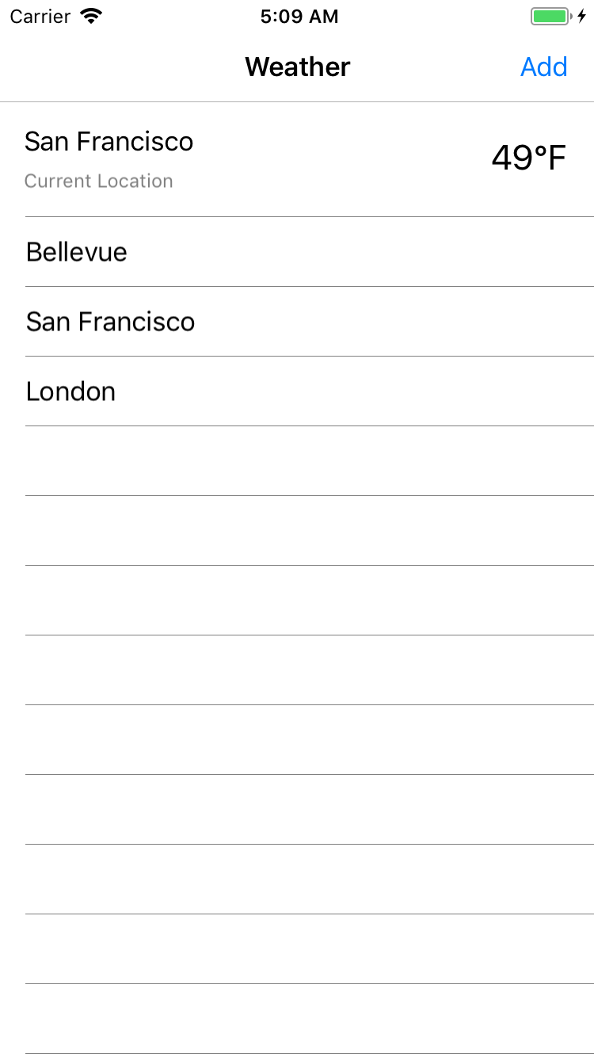
Exercise 3: Implement a DataTemplateSelector
Create a WeatherRequestDataTemplateSelector that returns a different DataTemplate for LocationWeatherRequest and WeatherRequest
Apply that DataTemplateSelector to ListView so that the LocationWeatherRequest at the top shows the current location and temperature, as shown.

Slide 40
Q & A

Slide 41
Additional resources
To learn more, refer to the following Xamarin University courses:
XAM320, Model-View-ViewModel in Xamarin.Forms
XAM270, Data Binding in Xamarin.Forms
XAM280, Using ListView in Xamarin.Forms
XAM312, Customizing the ListView in Xamarin.Forms

Slide 42
Customization

Slide 43
Customization
Xamarin.Forms offers a variety of ways to customize your application.
OnPlatform: for simple platform-specific customizations such as adding requisite padding to a view
Custom renderers: when you need more flexibility and customization than you would get by using an effect, for example:
to override methods of a platform-specific control
to replace the platform-specific control that implements a Xamarin.Forms control
Behaviors: for cross-platform customizations
Effects: for platform-specific customizations
Native Forms: for embedding a Xamarin.Forms ContentPage into a native app

Slide 44
OnPlatform
Note: Use sparingly
Use Device.OnPlatform for platform-specific tweaks on styles in code
In code
In XAML
switch(Device.RuntimePlatform)
{
case Device.iOS:
MainPage.BackgroundColor = Color.Black;
break;
case Device.Android:
MainPage.BackgroundColor = Color.Red;
break;
default:
MainPage.BackgroundColor = Color.Transparent;
break;
}
#Syntax 1
<circle:CircleImage HorizontalOptions="Center" WidthRequest="{OnPlatform iOS=32, Android=32}"
HeightRequest="{OnPlatform iOS=32, Android=32}"/>
#Syntax 2
<StackLayout>
<StackLayout.Padding>
<OnPlatform x:TypeArguments="Thickness">
<On Platform="Android, UWP" Value="0, 0, 0, 0"/>
<On Platform="iOS" Value="0, 20, 0, 0"/>
</OnPlatform>
</StackLayout.Padding>
</StackLayout>

Slide 45
Custom renderers
Custom renderers provide a powerful approach for customizing the appearance and behavior of Xamarin.Forms controls. They can be used for small styling changes or sophisticated platform-specific layout and behavior customization.
Anything that can be achieved with an effect can also be achieved with a custom renderer. However, custom renderers offer more flexibility and customization than effects
Custom renderers are required when there's a need to override methods of a platform-specific control
Custom renderers are required when there's a need to replace the platform-specific control that implements a Xamarin.Forms control
Notes:
Xamarin.Forms user interfaces are rendered using the native controls of the target platform, allowing Xamarin.Forms applications to retain the appropriate look and feel for each platform.
https://developer.xamarin.com/guides/xamarin-forms/custom-renderer/

Slide 46
Implementing a custom renderer
Create the Xamarin.Forms view
Implement the platform-specific renderer for that view
Export the renderer for the view via an assembly attribute

Slide 47
Implementing a custom renderer: Creating the view
public class ThermometerView : Xamarin.Forms.View { public static readonly BindableProperty TemperatureProperty = BindableProperty.Create( propertyName: nameof(Temperature), returnType: typeof(double), declaringType: typeof(ThermometerView), defaultValue: 0.0d); public double Temperature { get { return (double)GetValue(TemperatureProperty); } set { SetValue(TemperatureProperty, value); } } }

Slide 48
Implementing a custom renderer: Creating the renderer
[assembly: ExportRenderer(typeof(ThermometerView), typeof(ThermometerRenderer))] namespace MyWeather.iOS { public class ThermometerRenderer : ViewRenderer<ThermometerView, NativeThermometerView> { NativeThermometerView nativeView; protected override void OnElementPropertyChanged(
object sender,
System.ComponentModel.PropertyChangedEventArgs e) { } protected override void OnElementChanged(ElementChangedEventArgs<ThermometerView> e) { if (Control == null) { nativeView = new NativeThermometerView(); SetNativeControl(nativeView); } if (e.OldElement != null) { /* Unsubscribe */ } if (e.NewElement != null){ /* Subscribe */ } } } }

Slide 49
Consuming a custom renderer
You consume a custom renderer by referencing the custom control implemented by the custom renderer
The platform-specific renderer will be used automatically if available
<ContentPage
xmlns:local="clr-namespace:CustomRenderer;assembly=CustomRenderer">
…
<local:ThermometerView Temperature="{Binding Temperature}"/>
…
</ContentPage>

Slide 50
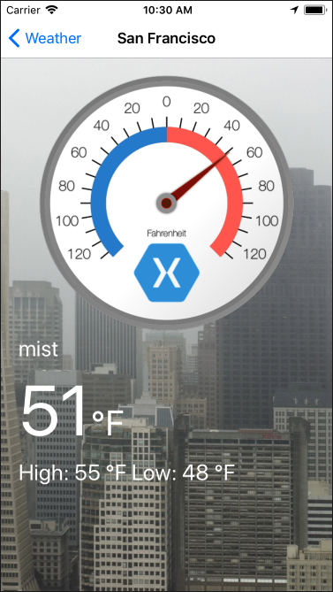
Exercise 4: Add a custom renderer
Create a ThermometerView custom control
Add a BindableProperty called Temperature
Implement a ThermometerRenderer custom renderer for your chosen platform
Place the custom control in the WeatherDetailView
Bind the custom control properties to the ViewModel

Slide 51
Behaviors vs. Effects
Use Behaviors to create generic UI functionality that applies to all platforms via the Xamarin.Forms abstraction of the controls. e.g. a TextValidation behavior
Use Effects to apply platform-specific UI functionality that is not exposed via the Xamarin.Forms abstraction. e.g. a RoundedCorners effect on iOS.
Xamarin.Forms
Behavior
iOS
Android
UWP
MacOS
Effect
Effect
Effect
Effect

Slide 52
Behaviors
New Entry behavior created by deriving from Behavior<T>
Behaviors let you add functionality to UI controls without having to subclass them.
Behaviors are written in code and added to controls in XAML or code.
public class TextValidationBehavior : Behavior<Entry>
{
protected override void OnAttachedTo(Entry entry)
{
entry.TextChanged += OnEntryTextChanged;
base.OnAttachedTo(entry);
}
protected override void OnDetachingFrom(Entry entry)
{
entry.TextChanged -= OnEntryTextChanged;
base.OnDetachingFrom(entry);
}
void OnEntryTextChanged(object sender, TextChangedEventArgs args)
{
double result;
bool isValid = double.TryParse (args.NewTextValue, out result);
((Entry)sender).TextColor = isValid ? Color.Default : Color.Red;
}
}
Notes:
The sample application demonstrates a NumericValidationBehavior, which highlights the value entered by the user into an Entry control in red, if it's not a double.
https://developer.xamarin.com/guides/xamarin-forms/behaviors/

Slide 53
Consuming behaviors
In XAML:
<Entry Placeholder="Enter a System.Double">
<Entry.Behaviors>
<local:TextValidationBehavior />
</Entry.Behaviors>
</Entry>
In code:
var entry = new Entry { Placeholder = "Enter a System.Double" };
entry.Behaviors.Add (new TextValidationBehavior ());
Notes:
Using a Xamarin behavior is as easy as adding it to the behaviors property of the control either in XAML or in code
https://developer.xamarin.com/guides/xamarin-forms/xaml/xaml-basics/xaml_markup_extensions/

Slide 54
Exercise 5: Add a behavior
Create a Behavior that can animate the image on the Detail view when the user double taps it
Attach that Behavior to the background image so that the whole image pulses when it’s doubled tapped
Note: The animation might achieve this by scaling the image up and down quickly. A GestureRecognizer can be used to detect the double tap.

Slide 55
Effects
Effects allow you to customize the native controls on each platform without having to implement a custom renderer. You typically use Effects for small styling changes.
Simplify the customization of a control
Reusable, and can be parameterized to further increase reuse
Recommended when changing the properties of a platform-specific control will achieve the desired result
Notes:
Avoids the need to write a custom renderer.
Allows changing properties of the native controls.

Slide 56
Implementing an Effect: The portable code
Create a subclass of the RoutingEffect class in the PCL/shared code
Reference the effect string ID by passing it in the constructor initializer
public class FocusEffect : RoutingEffect
{
public FocusEffect () : base (”MyFormsLibrary.Effects.FocusEffect")
{
}
}
Note: Where it is possible to do so, avoid the use of hard-coded string values. It’s preferable to define these in a single place and reference them in a strongly typed manner, for example:
public const string ResolutionGroupName = “MyFormsLibrary.Effects”;
…
public FocusEffect () : base ($"{MyFormsLibrary.ResolutionGroupName}.{nameof(FocusEffect)}")
Notes:
Further info about specific steps:
Step 4. This attribute sets a company-wide namespace for effects, preventing collisions with other effects with the same name. Note that this attribute can only be applied once per project.
Step 5. This attribute registers the effect with a unique ID that's used by Xamarin.Forms, along with the group name, to locate the effect prior to applying it to a control. The attribute takes two parameters – the type name of the effect, and a unique string that will be used to locate the effect prior to applying it to a control. The effect can then be consumed by attaching it to the appropriate control.

Slide 57
Implementing an Effect: The platform-specific code
The process for creating an Effect in each platform-specific project is as follows:
Create a subclass of the PlatformEffect class.
Override the OnAttached method and write logic to customize the control.
Override the OnDetached method and write logic to clean up the control customization, if required.
Add a ResolutionGroupName attribute to the effect class.
Add an ExportEffect attribute to the effect class.
Note: Only one ResolutionGroupName attribute can be used per assembly or you’ll get a confusing error.
Notes:
Further info about specific steps:
Step 4. This attribute sets a company-wide namespace for effects, preventing collisions with other effects with the same name. Note that this attribute can only be applied once per project.
Step 5. This attribute registers the effect with a unique ID that's used by Xamarin.Forms, along with the group name, to locate the effect prior to applying it to a control. The attribute takes two parameters – the type name of the effect, and a unique string that will be used to locate the effect prior to applying it to a control. The effect can then be consumed by attaching it to the appropriate control.

Slide 58
Implementing an Effect: The platform-specific code
using Xamarin.Forms;
using Xamarin.Forms.Platform.iOS;
[assembly:ResolutionGroupName (MyFormsLibrary.ResolutionGroupName)]
[assembly:ExportEffect (typeof(EffectsDemo.iOS.FocusEffect), nameof(MyFormsLibrary.FocusEffect)")]
namespace EffectsDemo.iOS
{
public class FocusEffect : PlatformEffect
{
protected override void OnAttached ()
{
try {
Control.BackgroundColor = backgroundColor = UIColor.FromRGB (204, 153, 255);
} catch (Exception ex) {
Console.WriteLine ("Cannot set property on attached control. Error: ", ex.Message);
}
}
protected override void OnElementPropertyChanged (PropertyChangedEventArgs args)
{
base.OnElementPropertyChanged (args);
try {
if (args.PropertyName == "IsFocused") {
if (Control.BackgroundColor == backgroundColor) {
Control.BackgroundColor = UIColor.White;
} else {
Control.BackgroundColor = backgroundColor;
}
}
} catch (Exception ex) {
Console.WriteLine ("Cannot set property on attached control. Error: ", ex.Message);
}
}
}
}

Slide 59
Consuming an Effect
Create an instance of the effect in code or XAML
Add the effect to the Effects property of the control to which you want to apply the effect
<Entry Text="Effect attached to an Entry" ...>
<Entry.Effects>
<local:FocusEffect />
</Entry.Effects>
...
</Entry>
public HomePageCS ()
{
...
entry.Effects.Add(Effect.Resolve($"{MyFormsLibrary.ResolutionGroupName}.{nameof(FocusEffect)});
...
}
Notes:
Further info about specific steps:
Step 4. This attribute sets a company-wide namespace for effects, preventing collisions with other effects with the same name. Note that this attribute can only be applied once per project.
Step 5. This attribute registers the effect with a unique ID that's used by Xamarin.Forms, along with the group name, to locate the effect prior to applying it to a control. The attribute takes two parameters – the type name of the effect, and a unique string that will be used to locate the effect prior to applying it to a control. The effect can then be consumed by attaching it to the appropriate control.

Slide 60
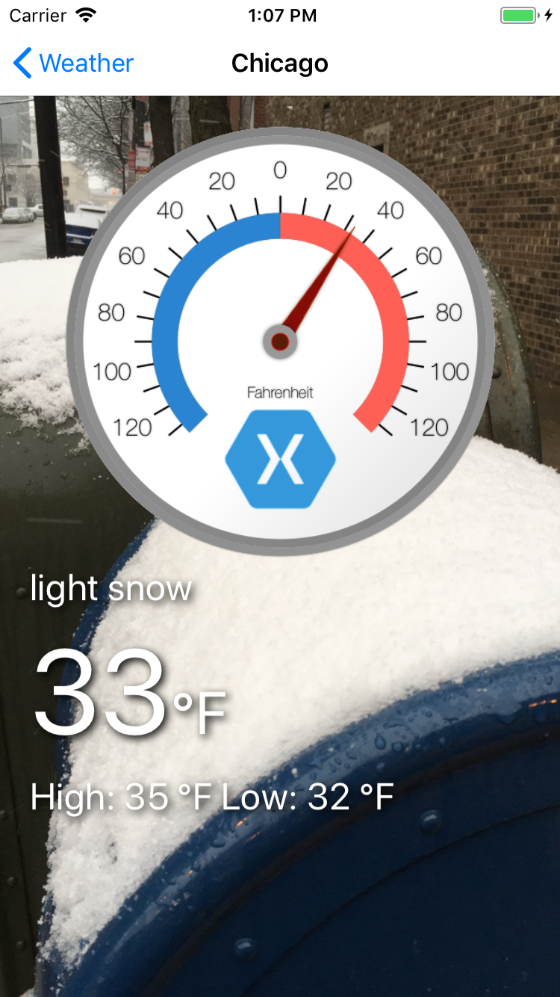
Exercise 6: Add an effect
Implement a drop shadow effect to add contrast to the labels on the Detail view
Apply that effect to all labels on the Detail view
Extend the effect to allow the drop shadow color to be changes in the XAML
HINT:
Create a RoutingEffect called ShadowEffect
Implement the PlatformEffect for iOS and Android

Slide 61
Xamarin.Forms Native Forms
Embed Xamarin.Forms ContentPages into Xamarin Native apps
Reference a Xamarin.Forms project (PCL or Shared)
Initialize Forms with Forms.Init();
Create native view container using extension methods
iOS: CreateViewController();
Android: CreateFragment(Context context); or CreateSupportFragment(Context context);
UWP: CreateFrameworkElement();
Add these native containers to the view

Slide 62
Xamarin.Forms Native Forms - iOS
UIViewController _historyViewController;
UINavigationViewController _navigation;
public override bool FinishedLaunching (UIApplication app, NSDictionary options)
{
Forms.Init();
...
}
public void ShowHistory()
{
if (_historyViewController == null)
_historyViewController = new HistoryPage().CreateViewController();
_navigation.PushViewController(_historyViewController, true);
}

Slide 63
Xamarin.Forms Native Forms - Android
Fragment _historyFragment;
public override void OnCreate (Bundle savedInstanceState)
{
Forms.Init();
...
}
public void ShowHistory()
{
if (_historyFragment == null)
__historyFragment = new HistoryPage().CreateSupportFragment(this);
var ft = SupportFragmentManager.BeginTransaction(); ft.AddToBackStack(null); ft.Replace(Resource.Id.fragment_frame_layout, _historyFragment, "HistoryPage"); ft.Commit();
}

Slide 64
Xamarin.Forms Native Forms - UWP
ContentPage _historyPage;
public override void OnLaunched (LaunchActivitedEventArgs e)
{
Forms.Init(e);
...
}
public void ShowHistory()
{
if (_historyPage == null)
__historyPage = new HistoryPage();
Frame.Navigate(_historyPage);
}
Xamarin.Forms exposes a method to pass a ContentPage directly to Frame.Navigate. Instead, you could also work with a FrameworkElement using a similar extension method

Slide 65
Xamarin.Forms Native Forms - Gotchas
Navigation
Xamarin.Forms navigation is not allowed—an exception will be thrown if used
Messaging
Native Forms extension methods do not map the events or custom class properties to the native view
Events and messaging should be done from the original ContentPage
Toolbar items
The ToolbarItem and Title properties on the ContentPage do not transfer to native view
Manually add the native toolbar item/title after you create the native view

Slide 66
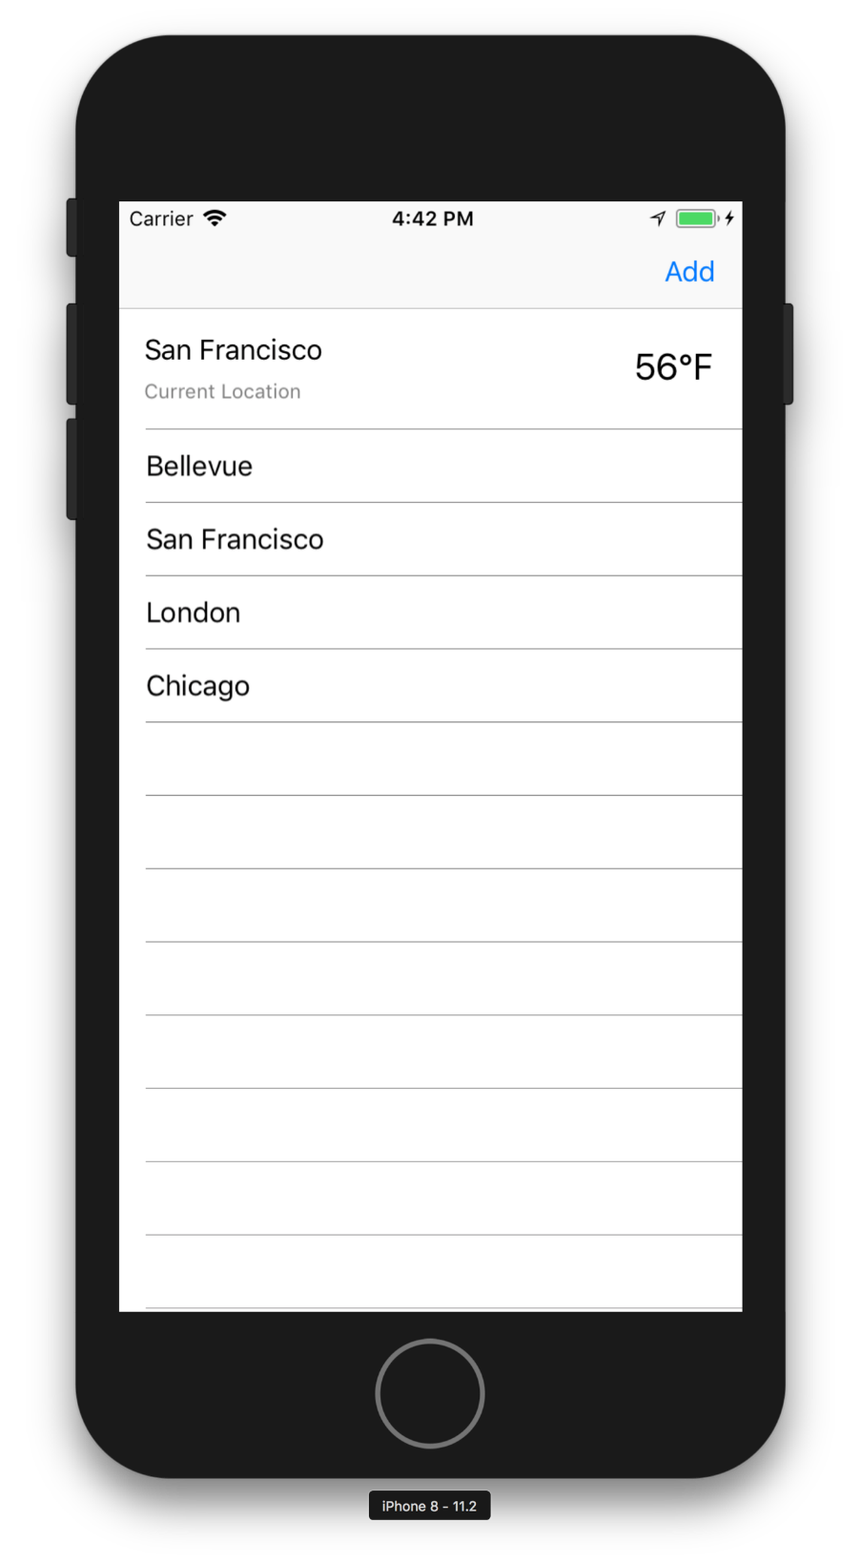
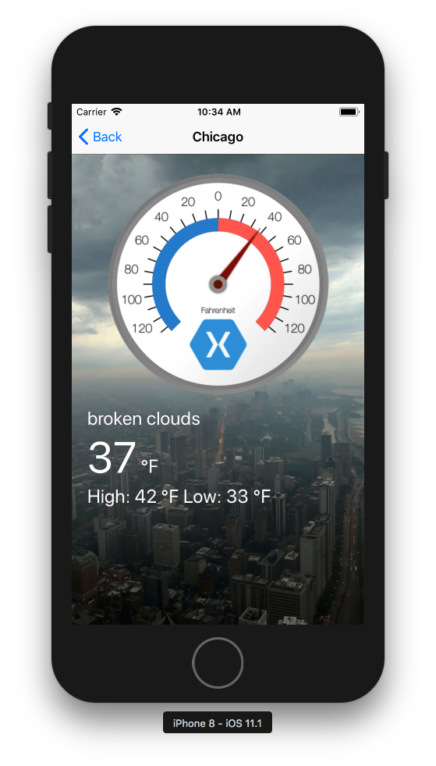
Exercise 7: Native Forms
Replace the Xamarin.Native implementation of the WeatherListPage with the Xamarin.Forms ContentPage
Use Native Forms to embed the ContentPage in our native platform app
Enable all functionality that existed on the Xamarin.Forms implementation of the page: navigation, toolbar items, pull-to-refresh etc.
Note: Add the Xamarin.Forms NuGet package to your platform project in order to access global::Xamarin.Forms.Forms.Init()

Slide 67
Additional customization
This section presents a few customization features of Xamarin.Forms that may or may not be useful.
Platform specifics: this feature lets you implement features or behaviors that only apply to one platform without requiring custom renderers
Native embedding: lets you use a native control into your Xamarin.Forms app
Native view declarations and bindings: let you to add bindable iOS, Android, and Windows views directly to XAML without requiring additional configurations
The Mobile Customer Advisory Team has yet to find a suitable use case for these features.

Slide 68
Platform-specifics
Let you implement features or behaviors that only apply to one platform without requiring custom renderers.
You can easily consume a platform-specific via a fluent code API or XAML.
Similar to effects, except that platform-specifics are generally only available on one platform, such as a translucent navigation bar on iOS.
Allows the Xamarin.Forms API surface to contain features that are only available on certain platforms for more platform-specific customization out-of-the-box.
For more information about bringing platform-specific functionality to Xamarin.Forms apps, see: https://blog.xamarin.com/bringing-platform-specific-functionality-to-xamarin-forms-apps/

Slide 69
Consuming platform-specifics
Consuming platform-specifics can be done in a two easy steps:
Bring in the Xamarin.Forms.PlatformConfiguration namespace and the corresponding namespace, as well as the corresponding platform-specific namespace (e.g. Xamarin.Forms.PlatformConfiguration.iOSSpecific, Xamarin.Forms.PlatformConfiguration.AndroidSpecific, etc.)
Apply the platform-specific using the On<T>()fluent API.
Several platform-specifics built into Xamarin.Forms are available now:
[iOS] Blur support for any VisualElement
[iOS] Translucent navigation bar
[Windows] Toolbar placement options
[Windows] Partially collapsed navigation bar (with icons) on MasterDetailPage
[Android] adjustResize/adjustPan

Slide 70
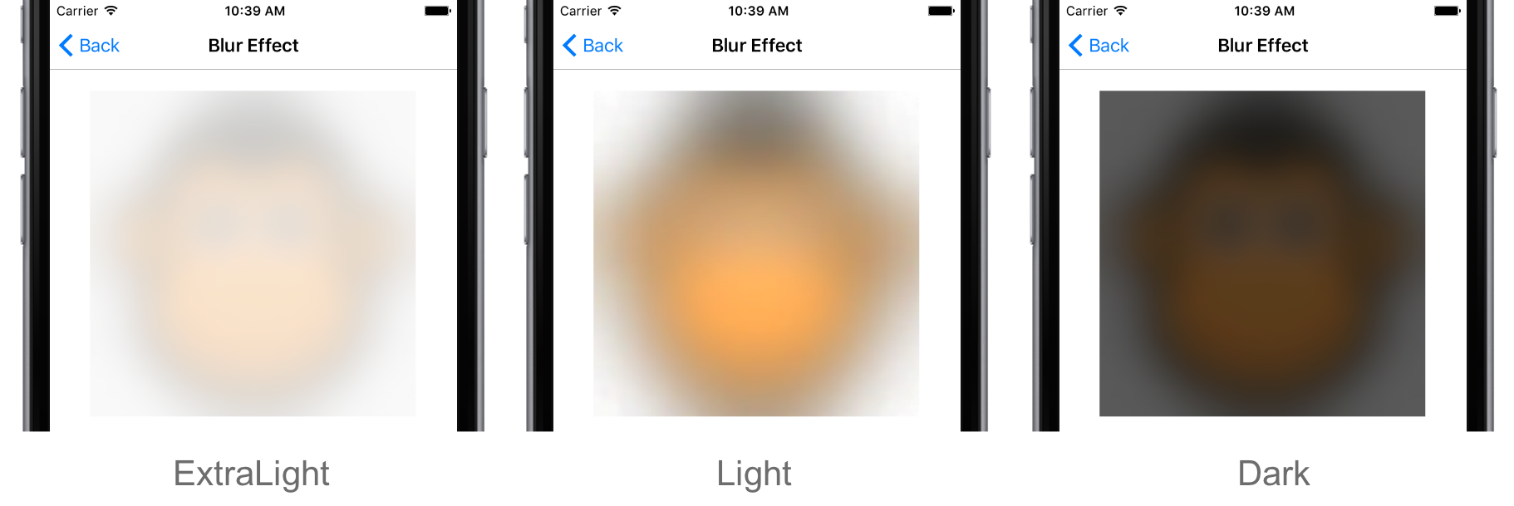
Platform-specifics
There are currently only a handful of implementations of platform-specifics available. One of the most notable uses is for applying the Blur effect easily on iOS UI controls.
xmlns:ios="clr-namespace:Xamarin.Forms.PlatformConfiguration.iOSSpecific;assembly=Xamarin.Forms.Core">
<BoxView x:Name="boxView" ios:VisualElement.BlurEffect="ExtraLight" HeightRequest="300" WidthRequest="300" />

Slide 71
Native embedding
Native iOS and Android controls embedded in a Xamarin.Forms page:
Allows easy placement of native controls directly in the Xamarin.Forms UI.
Requires the use of a shared project with #if compiler directive to use the native control on the target platform.
Notes:
Some natives control such as an iOS UISegmentedControl are not available as Xamarin.Forms controls as there are no equivalents on other platforms
There are several ways to extend Xamarin.Forms to fine-tune your apps’ user interfaces, including the use of custom renderers and, more recently, effects. Sometimes, though, you just want to take a native control and place it directly into your Xamarin.Forms application without any of the ceremony and code around these two other approaches. This is where the newly announced Native Embedding (Xamarin.Forms 2.2.0+) feature comes in, enabling you to easily add a native control to any Xamarin.Forms layout.
https://developer.xamarin.com/samples/xamarin-forms/UserInterface%5CNativeEmbedding/
https://blog.xamarin.com/embedding-native-controls-into-xamarin-forms

Slide 72
Native embedding on iOS
To pull in the platform-specific namespace
#if __IOS__
using Xamarin.Forms.Platform.iOS;
using UIKit;
using CoreGraphics;
#endif
Embedding an iOS UISegmentedControl and attaching an event handler
#if __IOS__
var segmentControl = new UISegmentedControl();
segmentControl.Frame = new CGRect(20, 20, 280, 40);
segmentControl.InsertSegment("One", 0, false);
segmentControl.InsertSegment("Two", 1, false);
segmentControl.SelectedSegment = 1;
segmentControl.ValueChanged += async (sender, e) =>
{
var selectedSegmentId = (sender as UISegmentedControl).SelectedSegment;
await MainPage.DisplayAlert($"Native Segmented Control Clicked {selectedSegmentId}",
"Whoa!!!!!!", "OK");
};
stack.Children.Add(segmentControl);
pageLayout.Children.Insert(0, stack);
#endif

Slide 73
Native embedding on Android
To pull in the platform-specific namespace
#if __ANDROID__
using Xamarin.Forms.Platform.Android;
using NativeTest.Droid; //Your Namespace
using Android.Views;
#endif
Embed an Android floating action button and attach a click event handler
#if __ANDROID__
var fab = new CheckableFab(Forms.Context)
{
UseCompatPadding = true
};
fab.SetImageResource(Droid.Resource.Drawable.ic_fancy_fab_icon);
fab.Click += async (sender, e) =>
{
await MainPage.DisplayAlert("Native FAB Clicked", "Whoa!!!!!!", "OK");
};
stack.Children.Add(fab);
absolute.Children.Add(stack);
AbsoluteLayout.SetLayoutFlags(stack, AbsoluteLayoutFlags.PositionProportional);
AbsoluteLayout.SetLayoutBounds(stack, new Rectangle(1f, 1f, AbsoluteLayout.AutoSize, AbsoluteLayout.AutoSize));
#endif

Slide 74
Native view declarations and bindings
Note: Use sparingly
Native view declaration lets you to add bindable iOS, Android, and Windows views directly to XAML with no additional configuration.
Unlike native embedding, native view declaration works in PCLs as well.
Native data binding will also work in PCLs, although you will need to ensure you have the XAML compiler (XAMLC) turned off for pages that use native view declaration.
For more information about adding bindable native views directly to XAML, see: https://blog.xamarin.com/adding-bindable-native-views-directly-to-xaml/

Slide 75
Adding native views to XAML
To make native views consumable via XAML, first add XML namespaces (markup xmlns) for each platform from which you’ll be embedding views to help Xamarin.Forms find the native control added to XAML.
Controls defined for XAML namespaces other than the specified target platform are ignored.
The target platform is automatically selected depending on which platform the app is running.
Next, add native view directly to your XAML
You can access all native properties for the control directly in your XAML as XML attributes, as well as view these properties via XAML IntelliSense.
If the native control requires use of arguments, pass these to the native control using the Arguments XML attribute.

Slide 76
Data binding native views
Although being able to add native views directly to XAML is great, many controls also require user interaction, such as entering text.
Data bindings allow properties of two objects to be linked so that a change in one causes a change in the other. Native view declaration supports data binding out of the box, so you can bind to properties of native views from within XAML.
Native view declaration supports both OneWay and TwoWay data bindings, which allows you to build very complex views.
OneWay data bindings propagate changes from the source to the target object
TwoWay data bindings propagate changes in both directions, allowing you to ensure that two views are always synchronized.

Slide 77
XAML native embedding example
This code offers an example of how to embed a native label control.
 | <?xml version="1.0" encoding="utf-8"?> <ContentPage xmlns="http://xamarin.com/schemas/2014/forms" xmlns:x="http://schemas.microsoft.com/winfx/2009/xaml" xmlns:ios="clr-namespace:UIKit;assembly=Xamarin.iOS;targetPlatform=iOS" xmlns:androidWidget="clr-namespace:Android.Widget;assembly=Mono.Android;targetPlatform=Android" xmlns:formsandroid="clr-namespace:Xamarin.Forms;assembly=Xamarin.Forms.Platform.Android;targetPlatform=Android" xmlns:win="clr-namespace:Windows.UI.Xaml.Controls;assembly=Windows, Version=255.255.255.255, Culture=neutral, PublicKeyToken=null, ContentType=WindowsRuntime;targetPlatform=Windows" x:Class="NativeViewDeclaration.NativeViewDeclarationPage"> <ContentPage.Content> <ios:UILabel Text="Native Text" View.HorizontalOptions="Start"/> <androidWidget:TextView Text="Native Text" x:Arguments="{x:Static formsandroid:Forms.Context}" /> <win:TextBlock Text="Native Text"/> </ContentPage.Content> </ContentPage>
Note the ability to pass required arguments in markup such as Context for Android.

Slide 78
Xamarin.Forms isn’t perfect
Xamarin.Forms solves many problems and is ideally suited for many common applications but it’s important to understand its limitations.
It still suffers from some common problems with mobile applications, e.g. memory and performance constraints on low spec devices.
Not really a write once/run anywhere solution
Font sizes not matching between platforms
Padding or margins varying between platforms
Subtle rendering differences
Subtle behavior differences
Notes:
No framework is perfect
same font size doesn’t match, paddings don’t match
Mobile dev can often by death by 1000 cuts. Forms is no different

Slide 79
Q & A

Slide 80
Additional resources
To learn more, refer to the following Xamarin University courses:
XAM330, Xamarin.Forms Effects
XAM335, Xamarin.Forms Renderers

Slide 81
Xamarin Forms 4.0

Slide 82
Xamarin Forms 4.0
Shell: Provides a simplified way to express the high-level navigation structure of your app in a single file (AppShell.xaml)
Visual: Aims to provide consistent control themes. Currently supports Material Design
CollectionView: New control with flexibility of layout and interaction
BindableLayout: Enhances any layout to accept a binding source and item template

Slide 83
Shell
Shell provides a guided structure for setting up an application.
Think of it as the evolution of the MasterDetailPage, NavigationPage, and TabbedPage.
It provides 3 tiers of elements to describe the application:
ShellItem: The top-level grouping of content represented by an item in the flyout. Can contain multiple ShellSections
ShellSection: Groups the content of your application. The content is navigable by bottom tabs. Can contain one or more ShellContent. Multiple ShellContent are navigable by top tabs.
ShellContent: The ContentPages of your application

Slide 84
Sample Shell XAML
<?xml version="1.0" encoding="UTF-8"?>
<Shell xmlns="http://xamarin.com/schemas/2014/forms"
xmlns:x="http://schemas.microsoft.com/winfx/2009/xaml"
xmlns:local="clr-namespace:NewApp"
RouteScheme="app"
RouteHost="microsoft.com"
Route="newapp"
x:Class="NewApp.AppShell">
<ShellItem Title="Home">
<ShellSection>
<ShellContent>
<local:MainPage />
</ShellContent>
</ShellSection>
</ShellItem>
</Shell>

Slide 85
Navigation via Routes
Shell provides routing navigation.
RouteScheme: URI scheme such as 'http' or 'app'
RouteHost: The domain portion of the URI
Route: The base segment of your app's URI
To programmatically navigate to the notifications page, the URI would be: “app://microsoft.com/newapp/a/b/notifications”
To register a route programmatically: Routing.RegisterRoute("greeting", typeof(GreetingPage));
Navigating to the GreetingPage: await (App.Current.MainPage as Shell).GoToAsync(new ShellNavigationState(new Uri("app://microsoft.com/newapp/greeting?msg=Hello"))); or (App.Current.MainPage as Shell).GoToAsync("app:///newapp/greeting?msg=Hello");
<ShellItem Title="Home" Route="a">
<ShellSection Route="b">
<ShellContent Route="home">
<local:MainPage />
</ShellContent>
<ShellContent Route="notifications">
<local:NotificationsPage />
</ShellContent>
</ShellSection>
</ShellItem>

Slide 86
Query Property
namespace NewApp.Pages
{
[QueryProperty("Message", "msg"]
public partial class GreetingPage : ContentPage
{
public GreetingPage()
{
InitializeComponent();
}
string _message;
public string Message
{
get { return _message; }
set
{
_message = value;
}
}
}
}
How is the query parameter "msg" handled from the query: (App.Current.MainPage as Shell) .GoToAsync ("app:///newapp/greeting?msg=Hello");
That's where the QueryProperty attribute comes in:

Slide 87
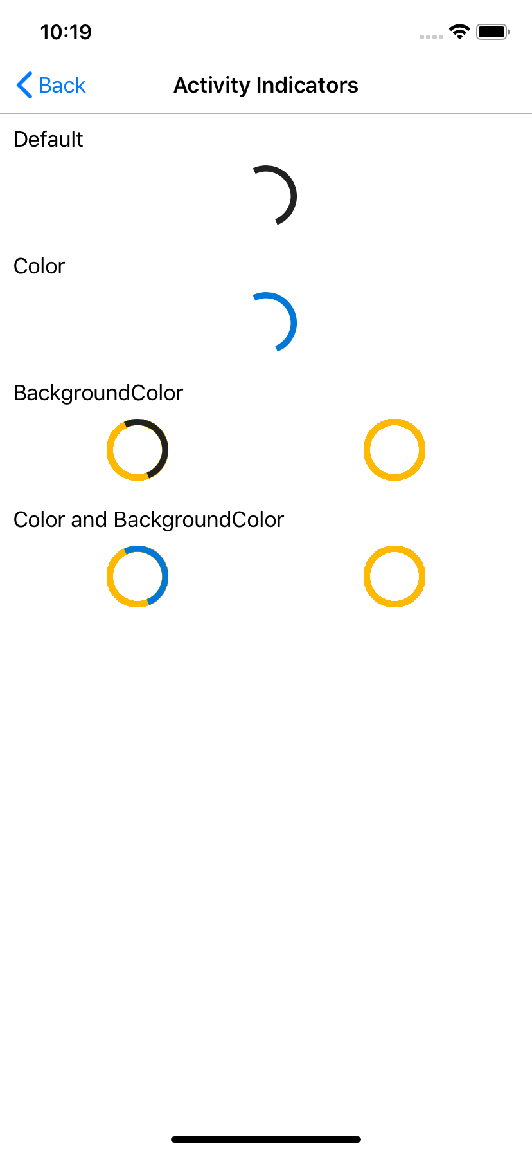
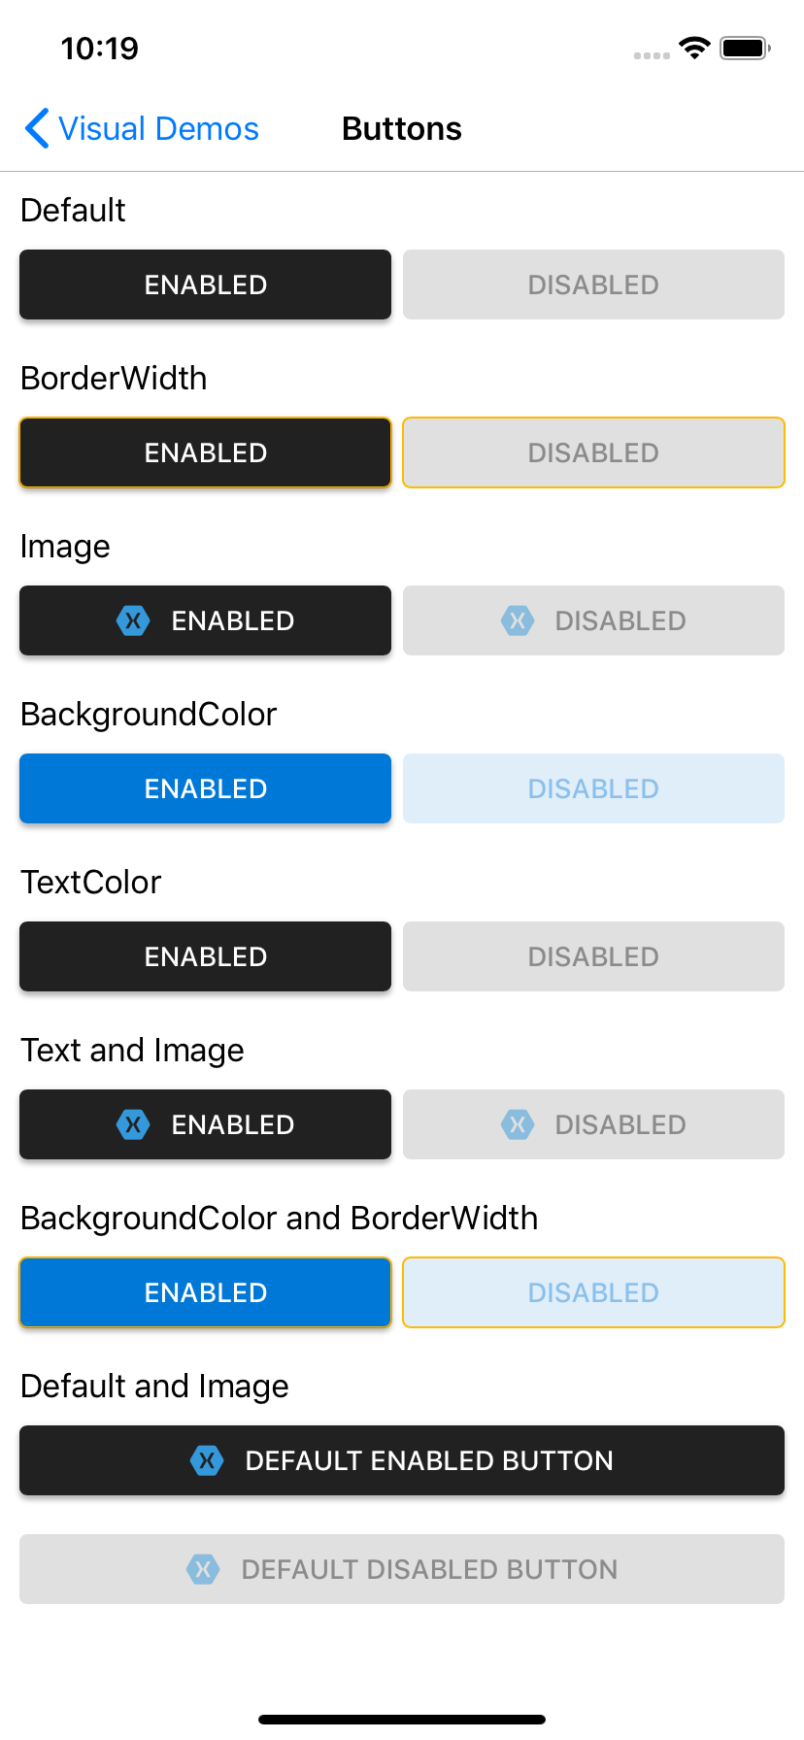
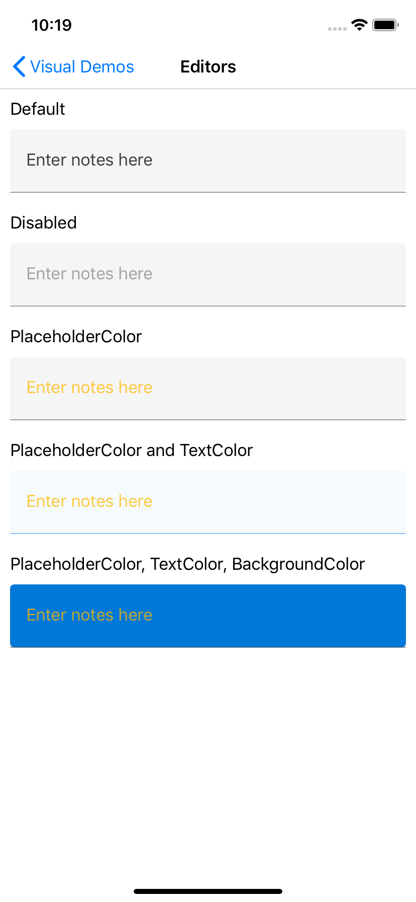
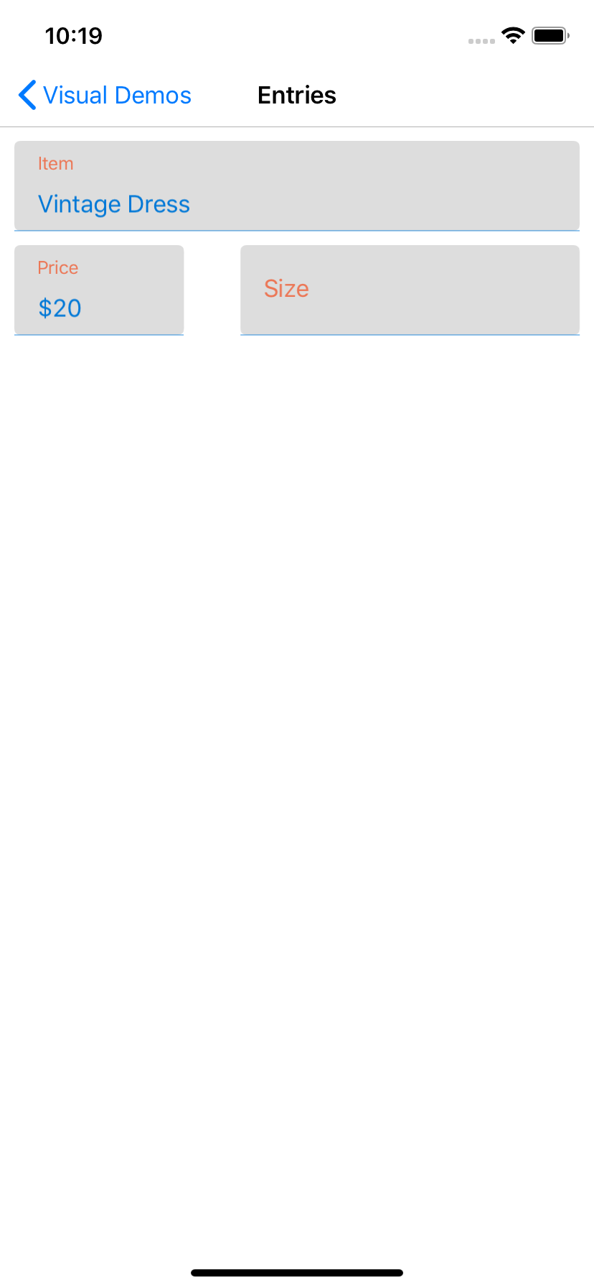
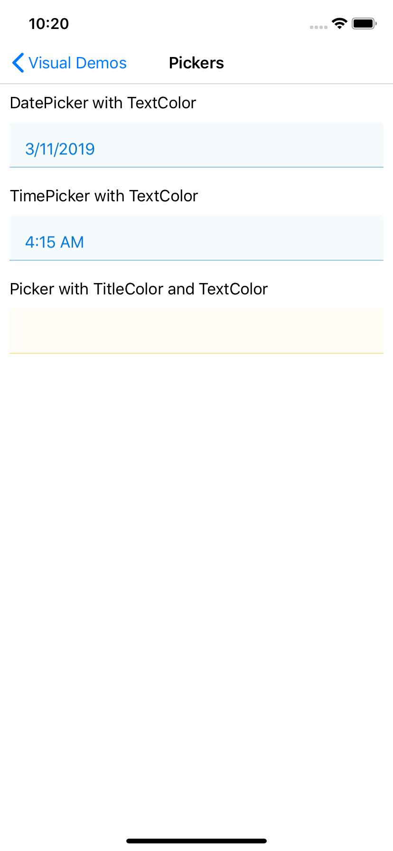
Visual
Visual is a set of custom renderers that provide a unified look and feel across platforms. Material Design by Google is currently in development

Slide 88
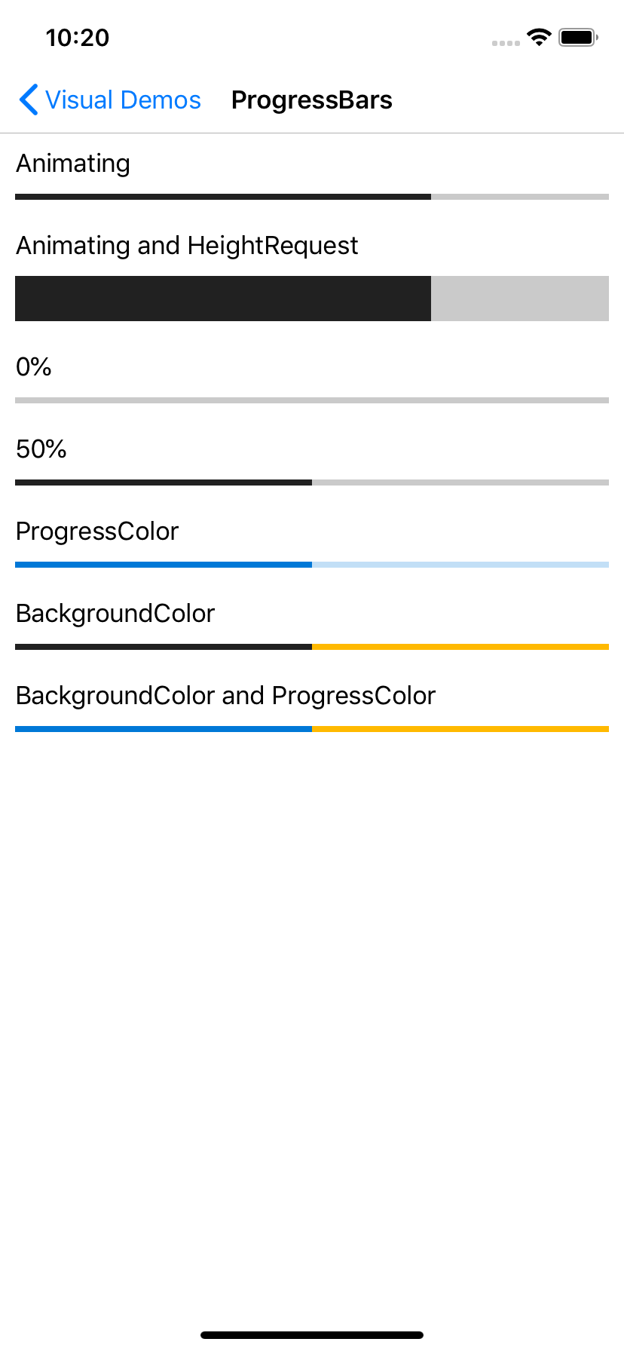
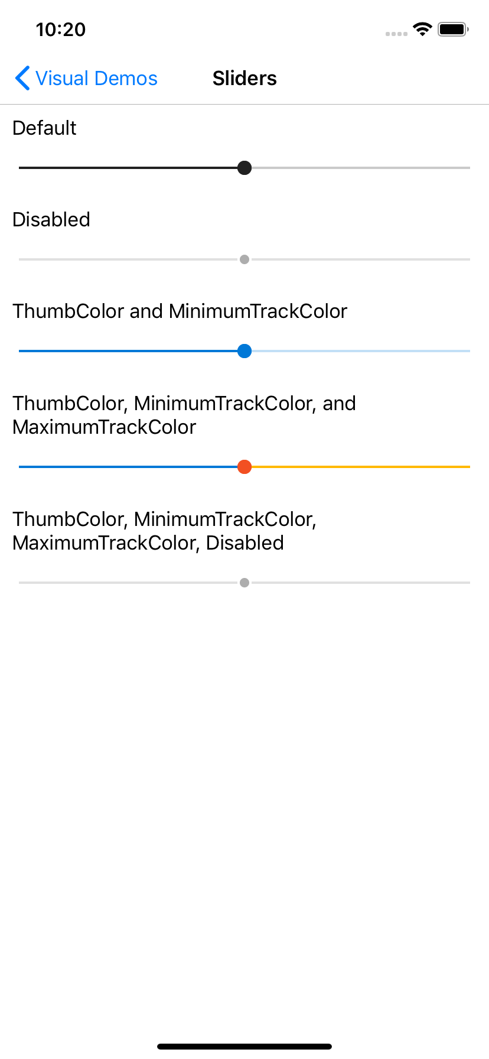
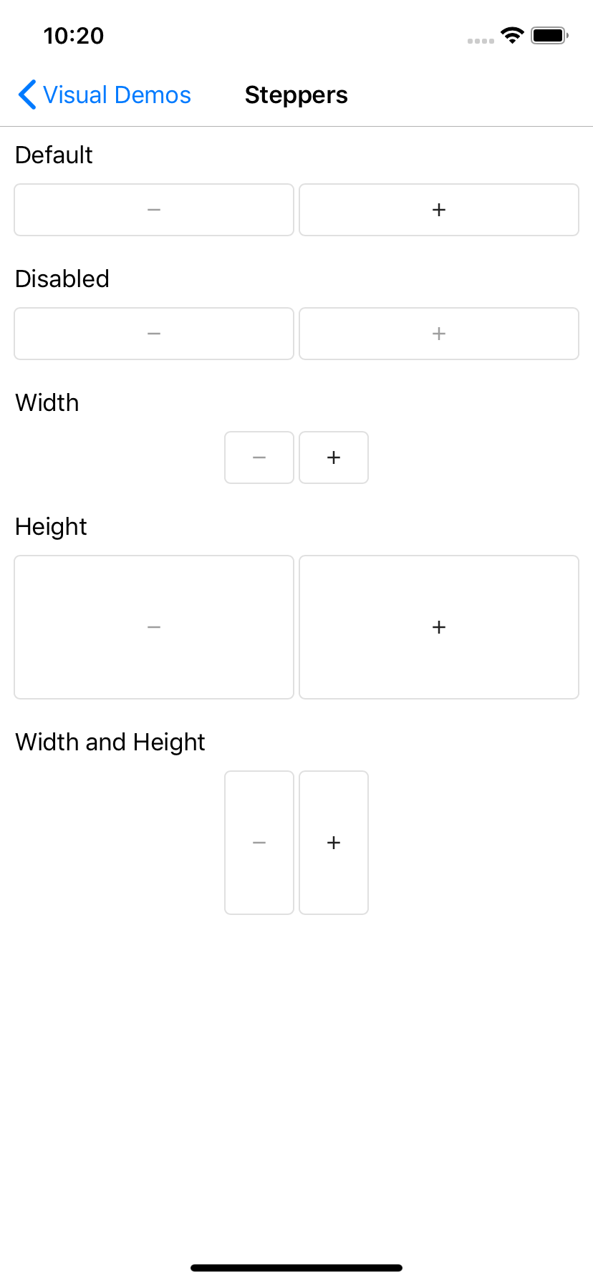
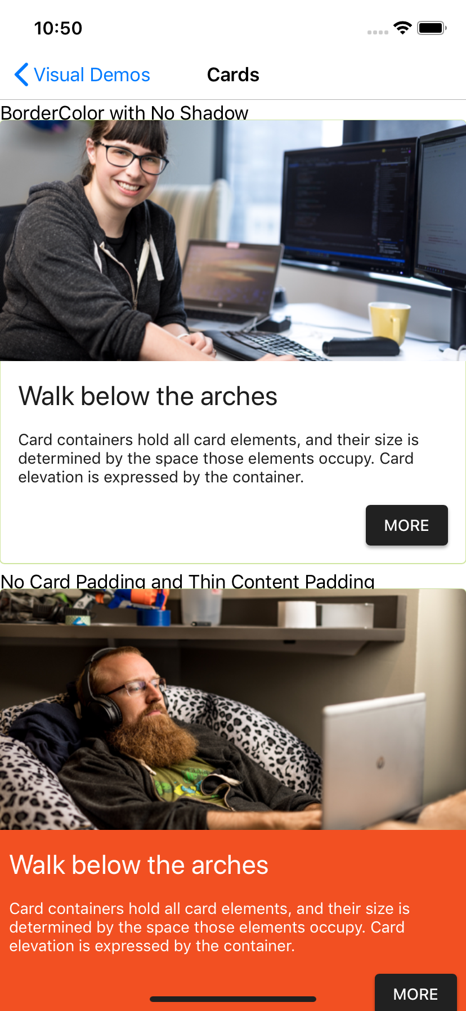
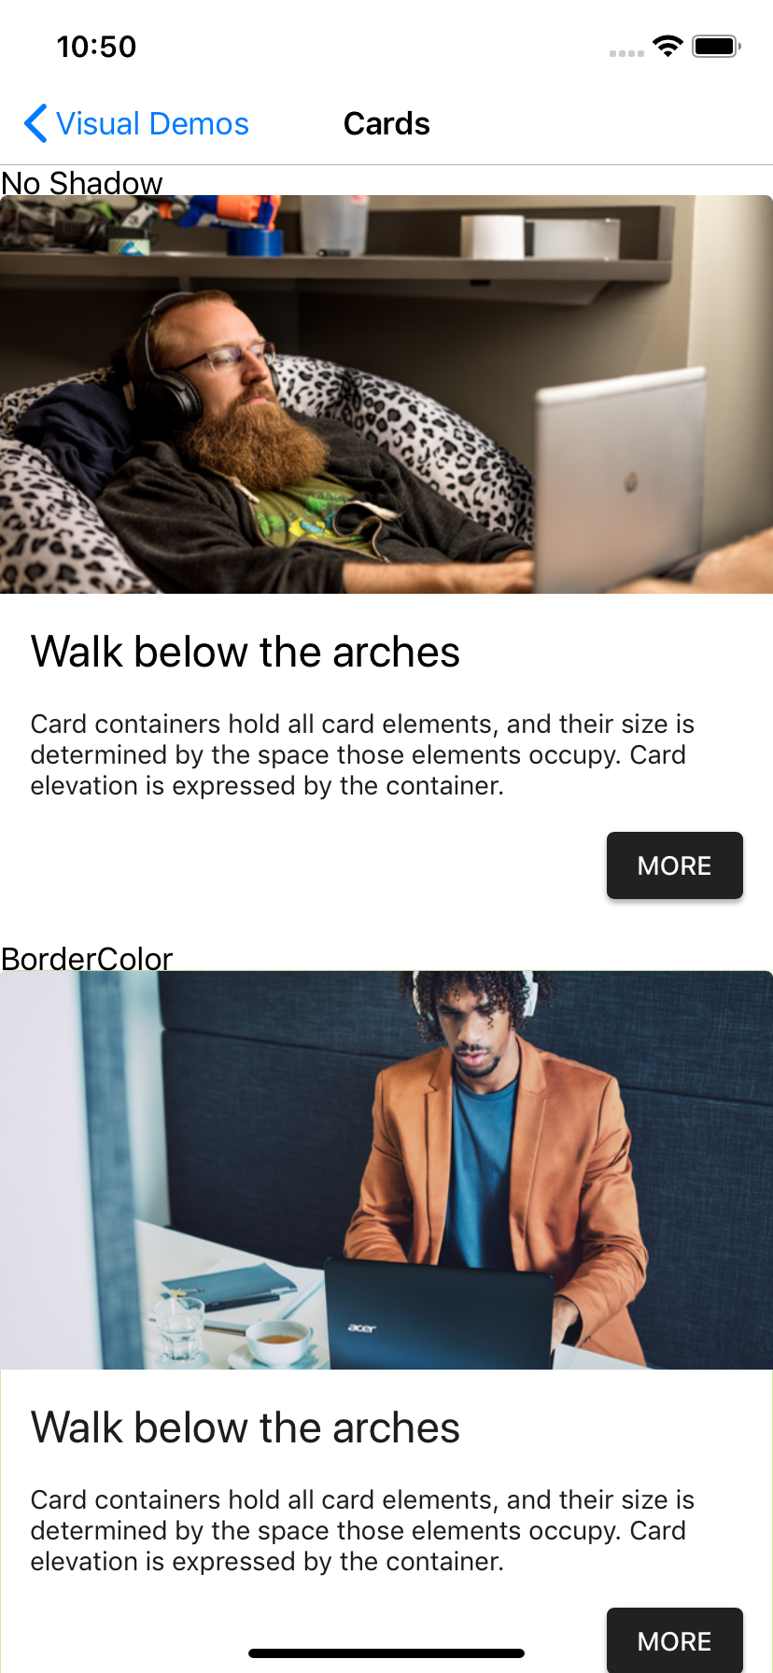
Visual
Visual is a set of custom renderers that provide a unified look and feel across platforms. Material Design by Google is currently in development

Slide 89
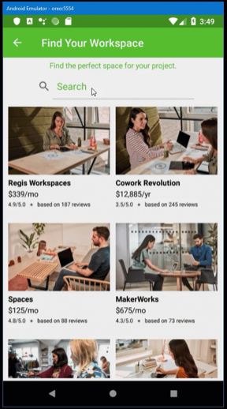
CollectionView
Collection view provides four layout combinations by default:
GridItemsLayout Horizontal
GridItemsLayout Vertical
ListItemsLayout Horizontal
ListItemsLayout Vertical
Custom layouts can be used in the future.

Slide 90
CollectionView Sample XAML
<StackLayout Margin="5">
<Label HorizontalOptions="Fill" HorizontalTextAlignment="Center"
Text="Find the perfect space for your project." TextColor="{StaticResource ThemeColor}"></Label>
<SearchBar x:Name="Search" HorizontalOptions="Center" BackgroundColor="White" TextColor="{StaticResource ThemeColor}"
PlaceholderColor="{StaticResource ThemeColor}" Placeholder="Search"></SearchBar>
<CollectionView x:Name="Spaces" Margin="0,5,0,0">
<CollectionView.ItemsLayout>
<GridItemsLayout Span="2" Orientation="Vertical" />
</CollectionView.ItemsLayout>
<CollectionView.EmptyView>
<StackLayout>
<Label FontAttributes="Bold" FontSize="18" Margin="10,25,10,10"
HorizontalOptions="Fill" HorizontalTextAlignment="Center"
Text="No results matched your filter."></Label>
<Label FontAttributes="Italic" FontSize="12"
HorizontalOptions="Fill" HorizontalTextAlignment="Center"
Text="Maybe try a broader filter?"></Label>
</StackLayout>
</CollectionView.EmptyView>
</CollectionView>
</StackLayout>

Slide 91
Bindable Layout
Any layout (Layout<T>) can be enhanced to accept a binding source and an item template.
Example of using a StackLayout within a ScrollView for a scrollable horizontal list of items:
Not all layouts are practical. Particularly AbsoluteLayout, Grid, and RelativeLayout because nesting these layouts is inneficient and problematic.
<ScrollView VerticalScrollBarVisibility="Never"
HorizontalScrollBarVisibility="Always">
<StackLayout BindableLayout.ItemsSource="{Binding ItemsSource}"
BindableLayout.ItemTemplateSelector="{StaticResource ItemTemplateSelector}"
Orientation="Horizontal"
Spacing="7"
Padding="10, 5" />
</ScrollView>

Slide 92
Additional resources
To learn more, refer to the following:
https://blog.xamarin.com/xamarin-forms-4-0-preview/
https://docs.microsoft.com/en-us/xamarin/xamarin-forms/release-notes/4.0/4.0.0-pre7

Slide 93
Q & A

